Slide 1





Demographic change in Central and Eastern Europe – European trends and national diversity
Tomáš Sobotka
Vienna Institute of Demography (Austrian Academy of Sciences), Wittgenstein Centre for Demography and Global Human Capital
Conference “Demographic Change in Central and Eastern Europe”, JPI More Years, Better Lives, Vienna 24 March 2015

Slide 2
The „Big Bang“ in 1989-91
The collapse of state-socialism in 1989-91
The system has become sclerotic, obsolete, unable to reform itself
Europe’s post-war political and economic order
Complete economic & social transformation, deeply affected the lives of all the people
New political and economic freedoms (including freedom to travel), new opportunities, market orientation and restructuring, economic uncertainty
Less paternalism, more inequality
Zygmund Bauman (1990: 187)
“What [Communism] could not do and did not brace itself to do was to match the performance of the capitalist market-centred society once that society abandoned its steel mills and coal mines and moved into the postmodern age …Soviet communism, as if to cast out devils, spent its energy on fighting wide trousers, long hair, rock music…”

Slide 3
European demographic divides, 1980s
Main demographic divisions and cleavages, East and West of Europe, 1980s
CEE contrasted with Western & Northern Europe:
Family and marriage almost universal, voluntary childlessness rare
Early family formation (unplanned pregnancies, shotgun weddings)
Higher mortality, stagnating health care
Restricted international migration (Iron Curtain was real…)
The absence of the Second Demographic Transition in the East
Less rapid pace of population ageing
Pronatalist family policies (only limited effect), often limited birth control, widespread abortion
Both East & West
Slow population growth, long-term shift to sub-replacement fertility
2-child family norm

Slide 4
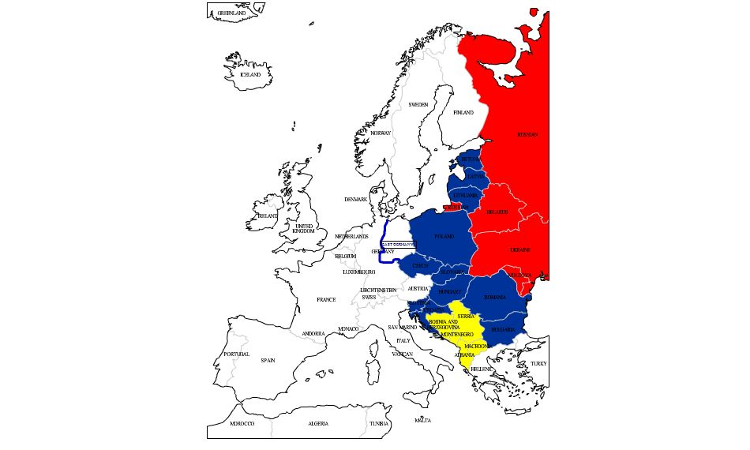
CEE divisions (1)
Eastern Europe / former USSR (ex. Baltic countries
Map creator: http://edit.freemap.jp/en
EU accession countries ((1990), 2004, 2007, 14)
Other countries / the Balkans

Slide 5
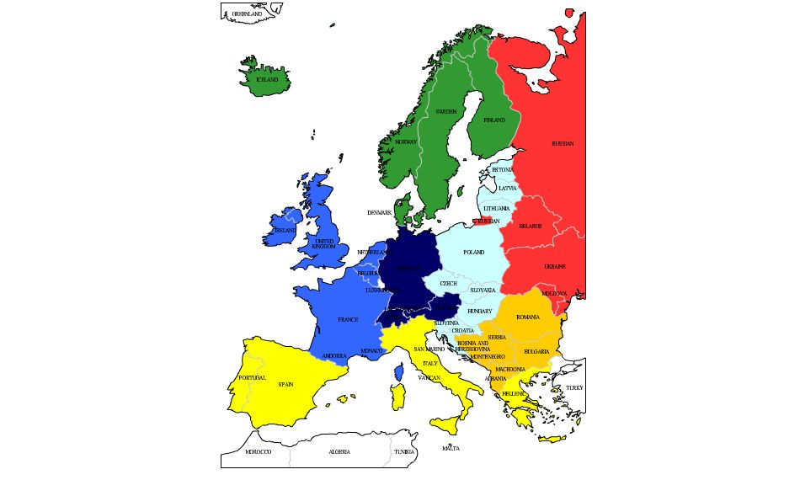
European divisions 1 (broader geographical regions)
Eastern Europe / former USSR (ex. Baltic countries
Nordic countries
Western Europe
Central Europe
“German-speaking” countries (DACH)
South-eastern Europe
Southern Europe
Map creator: http://edit.freemap.jp/en

Slide 6
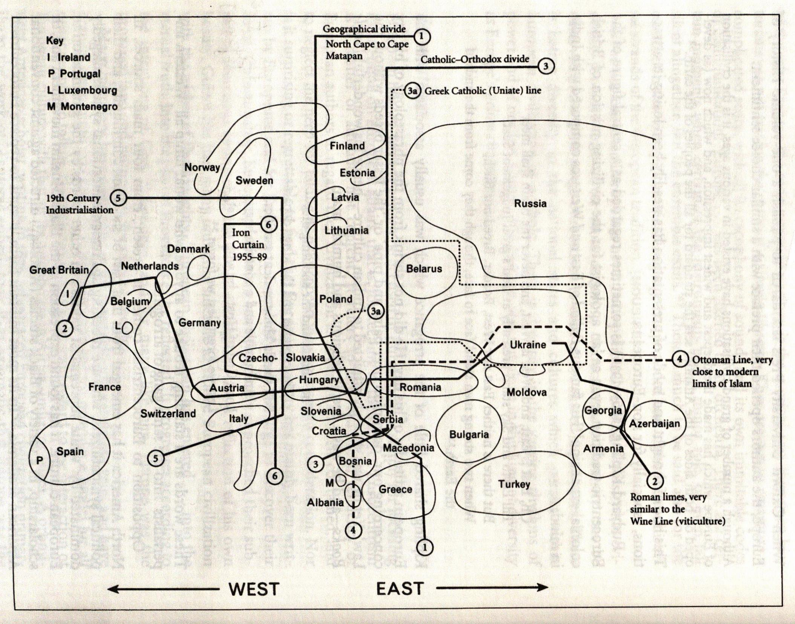
European divisions 2 (historical / cultural divisions)
Source: Norman Davies. 1997. Europe: A history. London: Pimlico / Random House.

Slide 7
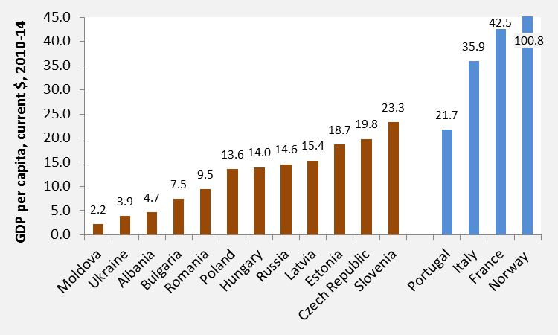
CEE diversity. New and re-emerging between-country differences and fault lines (1)
GDP per capita, current prices, US $, 2010-14 (source: World Bank)

Slide 8
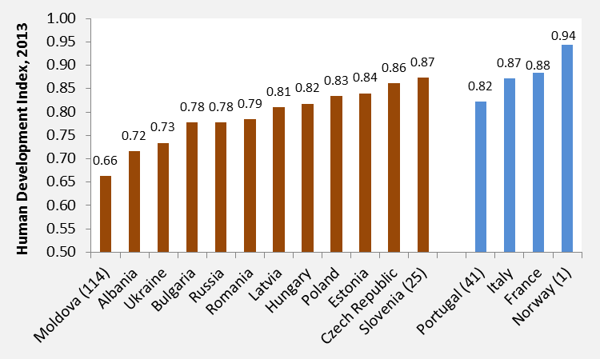
CEE diversity. New and re-emerging between-country differences and fault lines (2)
GDP per capita, current prices, US $, 2010-14 (source: World Bank)
Human Development Index, 2013
(source: UN; http://hdr.undp.org/en/data)

Slide 9
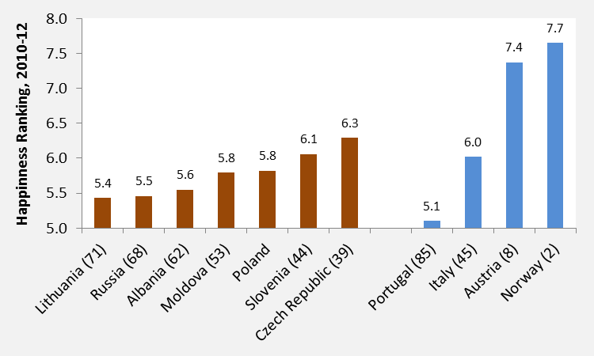
CEE diversity. New and re-emerging between-country differences and fault lines (3)
World Happiness Ranking, UN/Gallup 2010-12 (85 countries);
Source: http://en.wikipedia.org/wiki/World_Happiness_Report

Slide 10
Agenda
The Big Bang: reproduction transformed after 1989
Migration and population decline
Mortality and health: diverging trends
Population ageing: fastest in Europe?
“Our nation is dying”: The policy debates and responses
Discussion: The new CEE diversity?

Slide 11
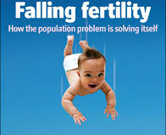
The big bang: reproduction transformed after 1989
economistmom.com

Slide 12
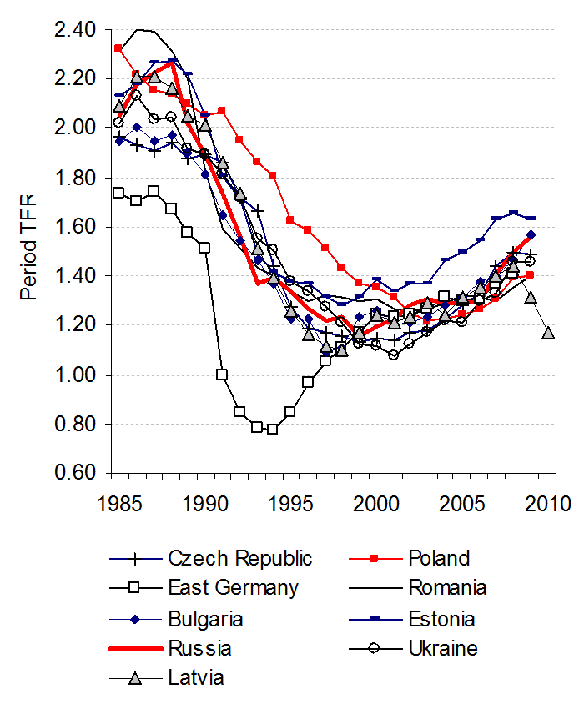
The „fertility collapse“ and its slow recovery
Period Total Fertility Rates, selected CEE countries, 1985-2010
1990s: seemingly uniform sharp fertility declines across CEE
2000s: partial fertility “recovery”
2008-12: differentiated reactions to the economic recession
Sources: Human Fertility Database, National statistical offices, Sobotka 2011

Slide 13
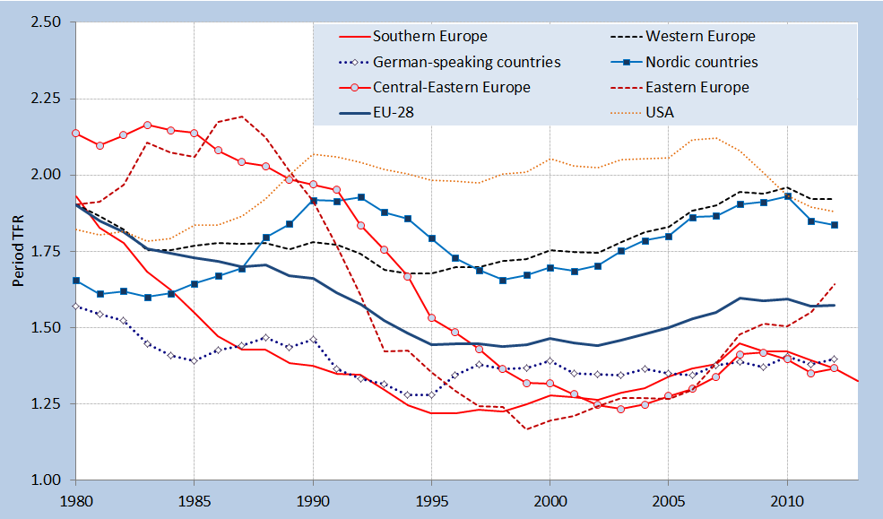
Period Total Fertility in broad European regions:
North & West vs. South & Centre & East
Source: European Demographic Data Sheet 2014 (VID/WIC 2014)

Slide 14
Mean age of mother at first birth, 1950-2011 (the Netherlands compared with five CEE countries)
Source: Human Fertility Database, National statistical offices, Sobotka 2011

Slide 15
Cohort fertility trends and variation
Observed and projected completed cohort fertility in selected regions in Europe, East Asia and in the United States, 1970-2012
Myrskylä, M., J. Goldstein, and Y. Alice Cheng. 2012. “New Cohort Fertility Forecasts for the Developed World: Rises, Falls, and Reversals.” Popul. Dev. Rev. 39 (1): 31–56.

Slide 16
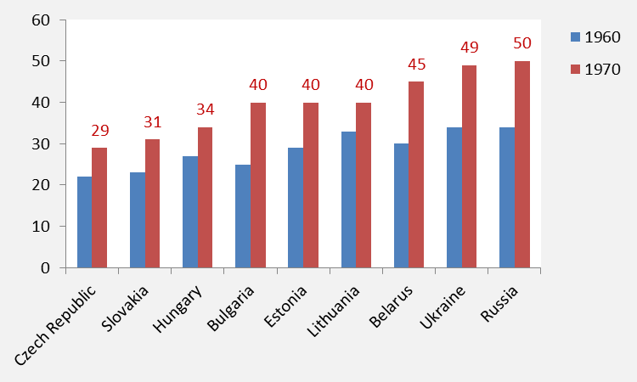
A rapid increase in one-child families
Share of women with a small family size (0 or 1), cohorts 1960 and 1970 (%)
S. Basten, T. Frejka et al. 2015. “Fertility and Family Policies in Central and Eastern Europe.” Barnett Papers in Social Research 15-01; Table 5.

Slide 17
The explosion of non-marital childbearing (%)
Source: Eurostat, National statistical offices, Sobotka 2011

Slide 18
Marriage postponed or foregone?
First marriage intensity among women in 5 CEE countries, France and Netherlands, 1990-2012 (indicators based on first marriage table)
Total first mar. intensity (per woman) Probability of marrying < age 25
Source: Computed by Caroline Berghammer, based on Eurostat (2015) database

Slide 19
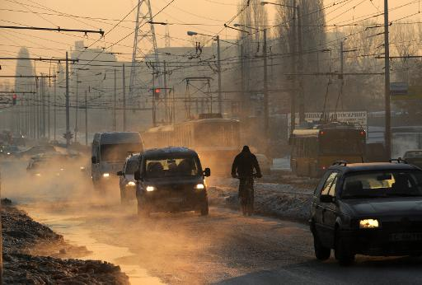
Mortality and Health: diverging trends
Kremikovtzi steel mill area, suburbs of Sofia
Source:
http://phys.org/news/2014-02-bulgaria-air-pollution-fuelled-poverty.html

Slide 20
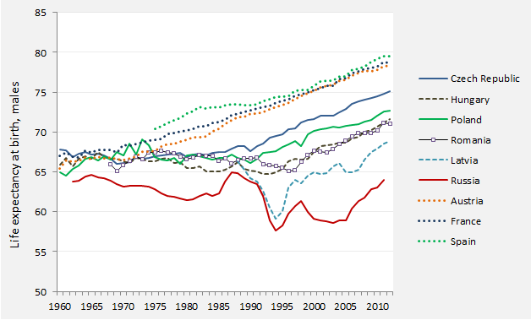
East-West and East-East contrasts in life expectancy at birth, males, 1960-2012
Data source: Eurostat 2015, Council of Europe 2006, Vishnevsky 2013, Tab. 8.2

Slide 21
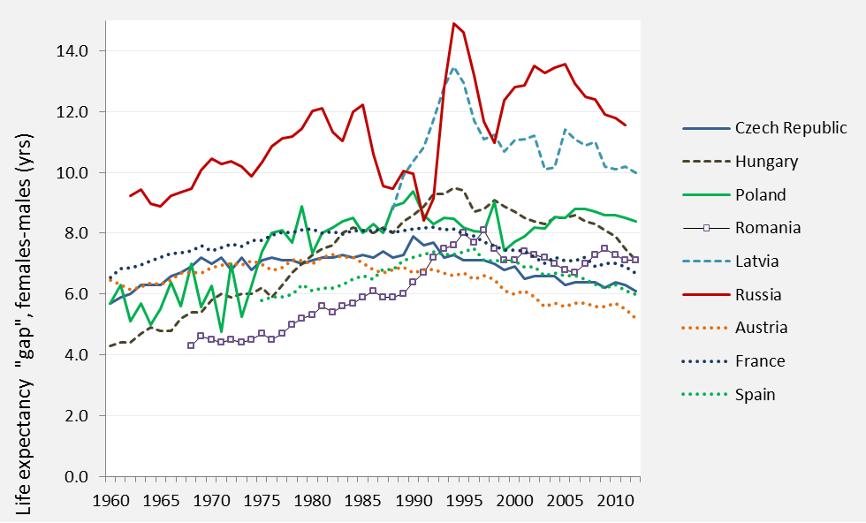
Life expectancy at birth: Female mortality advantage (years)
Data source: Eurostat 2015, Council of Europe 2006, Vishnevsky 2013, T8.2

Slide 22
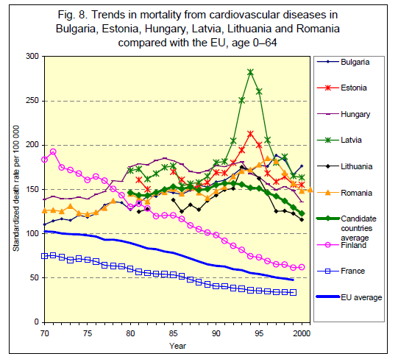
Why some countries having so negative trend in mortality in the 1990s
A combination of lifestyle factors + economic factors; also a collapse or a deterioration of the healthcare system
A spike in cardiovascular diseases, ischemic hearth diseases, external causes (incl. suicide), cancer (esp. Hungary)
Data source: WHO and EC Report 2002; http://ec.europa.eu/health/ph_projects/1999/monitoring/health_status_overview_en.pdf

Slide 23

Migration and population decline
Source: European Parliament,
http://www.europarl.europa.eu

Slide 24
The incredible shrinking region?
Population change since the 1990s: The triple forces of falling or low fertility, negative migration balance, and in some regions high mortality, esp. of men
Huge differences in migration & mortality trends
Cumulative pop. Decline 1989-2012/13: ca 23 million out of 360 million
Emigration driven by the economic slump, uncertainties & low living standards combined with the lifting of the travel restrictions
EU members: access to labour market & social protection in other countries (with a delay) fuelled increased migration
Also the effects of the recession, 2008-12
Unreliable data, frequent undercounts, adjustments at the Census
Rough estimate of net migration loss, without Russia: 8-10 million in 1989-2013 out of pop. 212 mill (including eastern Germany); 6-8 million ex. Eastern Germany; Russia: migr. gain of 8.3 mill in 1989-2012

Slide 25
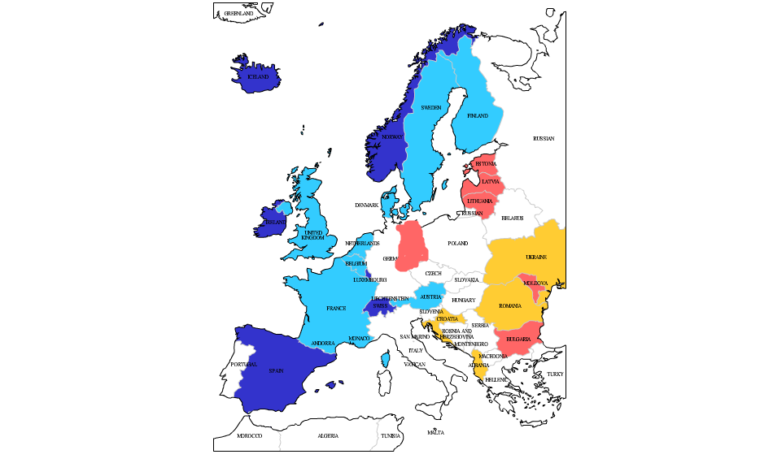
East-West division in relative population change, 1989-2013, in %
Decline 15-25%
Decline 10-14%
Increase 10-19 %
Increase 20+ %
Data source:
Own elaboration of Eurostat 2015
Map creator: http://edit.freemap.jp/en

Slide 26
Relative population change, 1989-2012 or 2013: Net migration vs. Natural pop. increase
Data source: Eurostat 2015, national statistical offices, www.pdwb.de

Slide 27

Managing population decline & ageing
Depopulating towns in Eastern Germany
Older streets are gap-toothed where wreckers have removed abandoned houses. Cityscapes are being pruned, removing dead and dying edifices in the hope of saving the rest.
Tearing itself down
Economist, April 10, 2008
Aschersleben, Saxony-Anhalt
Source: The Economist, http://www.economist.com/node/11025721

Slide 28
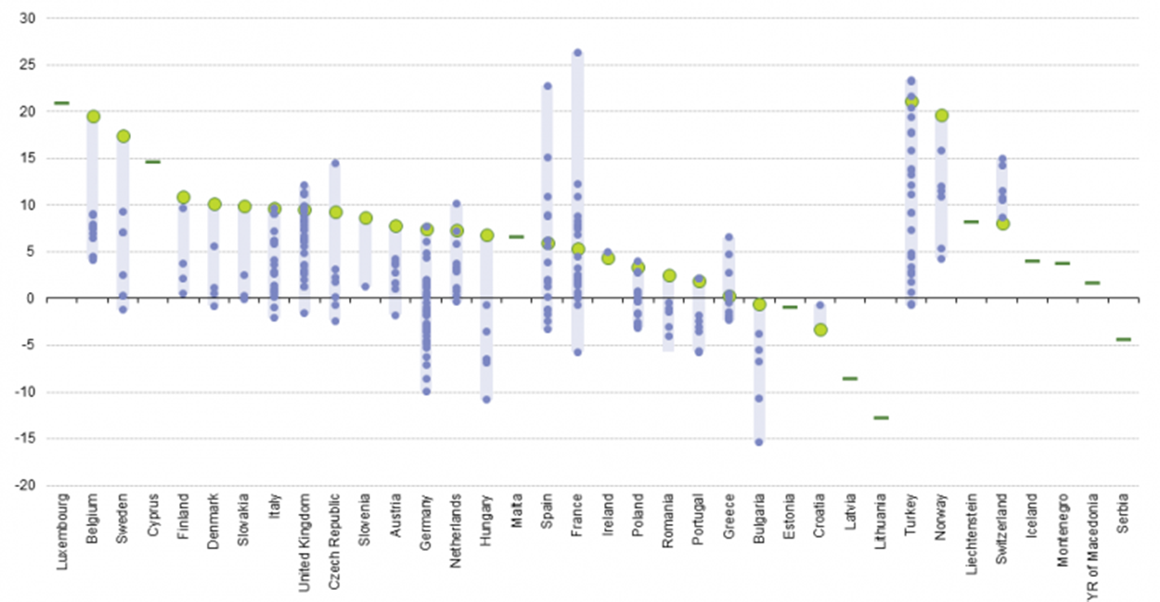
Regional differences in population change: the drive of the capital cities?
Average rate of population change (per thousand), NUTS-2 regions in Europe, 2008-12
Source: Eurostat database, http://ec.europa.eu/eurostat/statistics-explained, picture RYB14.png; accessed 23 March 2015

Slide 29
Sex- and age-specific differentials in migration
In most countries migration strongly concentrated into ages 18-35
Also sex differentials
Highly educated leave more frequently
Strong effects on reproduction/number of births, labour force size and human capital distribution of the population

Slide 30
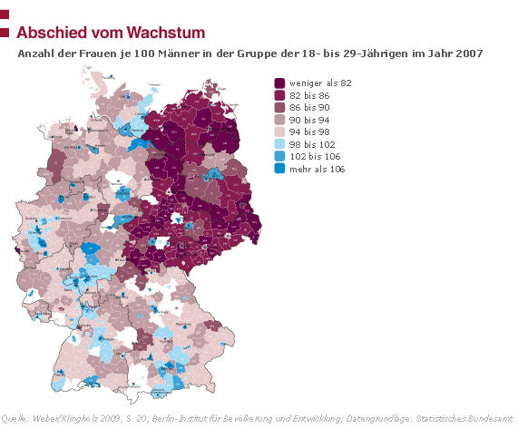
Sex- and age-specific differentials in migration
In most countries migration strongly concentrated into ages 18-35
Also sex differentials
Highly educated leave more frequently
Strong effects on reproduction/number of births, labour force size and human capital distribution of the population
Number of women per 100 men aged 18-27 in German districts, 2007
The “left over” men in eastern Germany
Source: Berlin Institute 2010, http://www.berlin-institut.org/publikationen/studien/not-am-mann.html

Slide 31
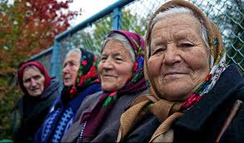
Population ageing: fastest in Europe?
Source:
http://blog.ted.com/a-story-of-people-not-radiation-a-conversation-about-chernobyl-and-fukushima/

Slide 32
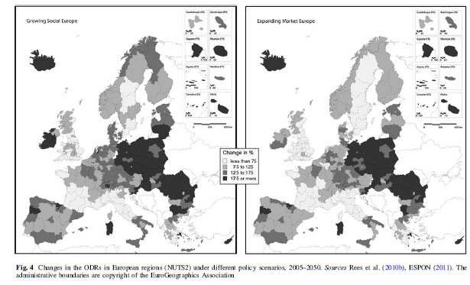
Projected changes in old-age dependency ratios in NUTS-2 regions of Europe, 2005-50
Rees, P. et al. 2012. “European regional populations: current trends, future pathways, and policy options.” European Journal of Population 28(4), 385-416.

Slide 33
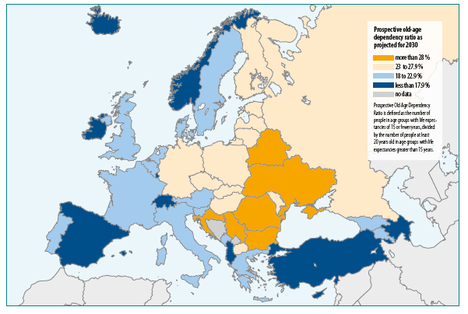
Prospective old-age dependency ratio, projected, 2030
Source: VID/Wittgenstein Centre 2012: European Demographic Data Sheet 2012

Slide 34
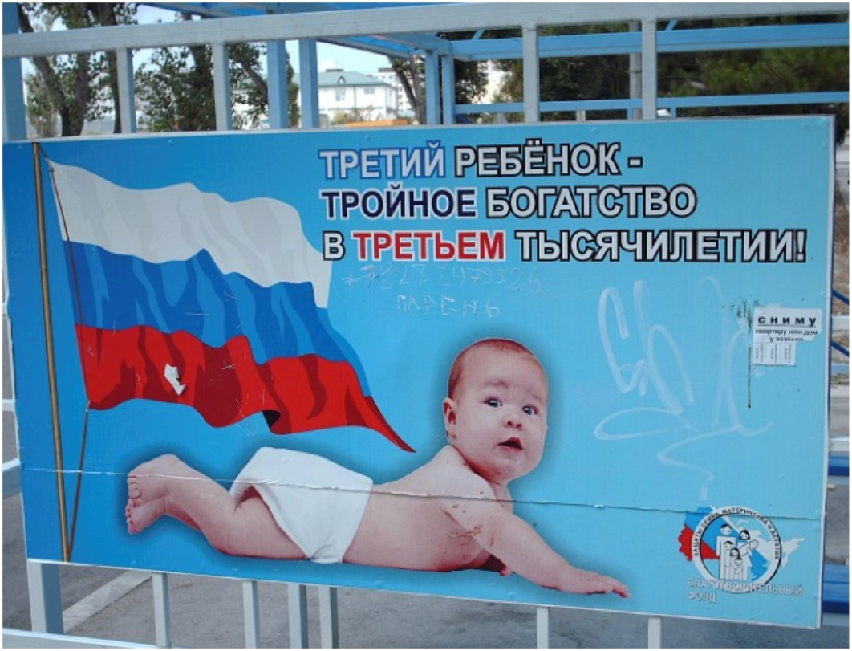
“Our nation is dying”: The policy debates and responses
Source:
somatosphere.net

Slide 35
Many governments think fertility is too low
Government view on fertility level and government policy on fertility in 22 countries ever reaching a period total fertility of 1.40 or below, 1996-2011
Source: Sobotka 2013; based on UN reports & UN World Population Policy Database; http://esa.un.org/PopPolicy/about_database.aspx

Slide 36
Public family & population policy discussions: different ideological underpinning
Demography high in political agenda in CEE
Family policies: the previous ones partly collapsing or abandoned
Policy reorientation often driven by ideological considerations & perceived need to lower government expenditures
1990s: declining childcare availability; shift to the more “traditional” support of the prolonged stay of mothers at home
Policy turbulences; lacking coherence, frequent changes
Hungary: the least “effective family policies”?
Eastern and SE Europe: the return of explicit pronatalism
  Russia, Ukraine, Belarus: strong support for 2nd & higher-order births (RUS: “maternal capital”; UKR: high childcare allowances)
  BG: nationalistic discussion on “Bulgaria’s collapse” coloured by strong anti-Roma sentiments (Kotzeva & Dimitrova 2014)

Slide 37
Selected policy trends in the EU-CEE countries after 2000
EU policies: also motivated by “enabling” people to fulfill their fertility intentions; not explicitly pronatalist
A slow expansion of public childcare coverage for children below age 3 (EU target to achieve at least 33% coverage in each country)
Shorter, but better paid parental leave, with remuneration up to 100% of the previous wage (Estonia, Poland). Stimulating earlier return to employment
Flexible leave arrangements: more flexibility in selecting leave period, “multispeed leave” (Czech Republic)
Cash support to newborns and children: childcare allowances in Ukraine, “maternity capital” established at the time of child’s birth (second births in Russia)
Tax rebates

Slide 38
Policies addressing population ageing
Shifts to older retirement age in all countries; also abandoning the earlier retirement age among women
Limited or ineffective policies on retaining older workers; widespread prejudices and discrimination
The elderly bias in public spending

Slide 39
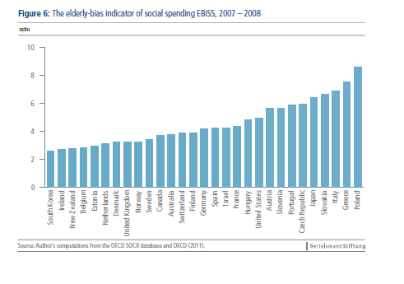
The elderly bias in social spending, OECD, 2007-8
Most pro-elderly biased countries: Poland, Greece, Italy, Slovakia, Czech Rep., Portugal, Slovenia, Austria, EBiSS>5
SOURCE: Vanhuysse, P. 2013. Intergenerational Justice in Aging Societies. A Cross-national Comparison of 29 OECD Countries. Gütersloh: BertelsmannStiftung, p. 27. www.sgi-network.org/pdf/Intergenerational_Justice_OECD.pdf‎

Slide 40
Discussion:
The new CEE diversity?

Slide 41
The new CEE demographic diversity
The CEE as a distinct “demographic region” no longer exists
New & re-emerging differences
Often more differentiation in population trends and behaviours than other parts of Europe: Migration, health & mortality, marriage trends, but also family-related values and attitudes
Surprisingly conservative and paternalistic gender attitudes and practice
Declining population in much of the region (except parts of Central Europe), rapid pace of aging
Vastly different experiences with shrinking populations: emigration key
Emigration combined with low fertility implies rapid pop. declines in Baltic countries, south-eastern Europe, and some ex-USSR countries
Countries with “only” low fertility experiencing much more gradual trends (ex. Ukraine)

Slide 42
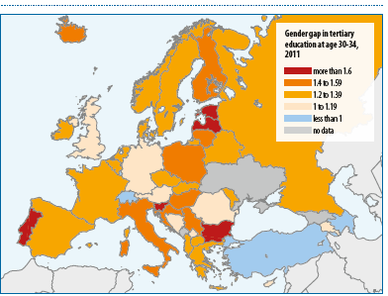
The importance of education transition
Rapid rise in tertiary education enrollment across the region, esp. among women
A key “explanation” of postponed family formation & lower fertility
Large education gradient in family size
Also more effective contraceptive use
Gender gap in tertiary education at age 30-34, Europe 2011
Source: VID/Wittgenstein Centre 2014: European Demographic Data Sheet 2014

Slide 43

tomas.sobotka@oeaw.ac.at
Work on this presentation was funded by the European Research Council under the European Union’s Seventh Framework Programme (FP7/2007-2013) / ERC Grant agreement n° 284238 (EURREP).
EURREP website: www.eurrep.org

