Slide 1
Central European Welfare Pathways Transition, Social Politics, and Population Aging
Pieter Vanhuysse
Professor of Comparative Welfare State Research
University of Southern Denmark
vanhuysse@sam.sdu.dk
http://www.sam.sdu.dk/ansat/vanhuysse
JPI Conference on ‘Demographic Change in Central and Eastern Europe’,
23 March 2015, BMW, Vienna

Slide 2
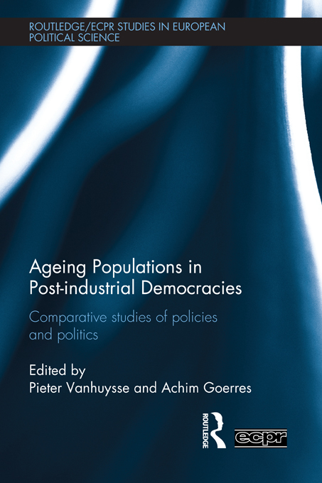
A tale of age-group politics and policies
Editorial intro, ‘Mapping the Field’: http://papers.ssrn.com/sol3/papers.cfm?abstract_id=1799348
Oxford blog for demographers: http://www.openpop.org/?p=403
Tepe, Markus & Vanhuysse, Pieter (2009), 'Are Aging OECD Welfare States on the Path to Gerontocracy? Evidence from 18 Democracies, 1980-2002,' Journal of Public Policy, 29 (1): 1-28. http://papers.ssrn.com/sol3/papers.cfm?abstract_id=1225672

Slide 3
Background: Growing alarmism about aging ➔ gerontocratic Europe
Sinn (2005): ‘Europe’s fun society is aging…fast. …. Hordes of pensioners, using the income received from the European pay-as-you-go pension systems, cruise the seven seas on luxury liners and jet off to the remotest beaches of our planet. The PAYG pension systems have made Europeans world champions in tourism and created a breathtaking infrastructure with seaside resorts and leisure centres from the Canaries to the Maldives and the beautiful Pacific Islands.’

Slide 4
Early choices and subsequent pathways towards Elderly Bias in Social Spending
EBiSS
… ?
Non-elderly retirement booms
time
t1 (early 1990s)
t2 (mid 1990s-late 2000s)
t3 (current decade)
t4…

Slide 5
Early Choices: t1
HU, PL: ‘Great Abnormal Pensioner Booms’ - despite young and slowly aging populations (Vanhuysse 2006)
1989-96: Nr. 60-plussers stable in HU, +10% in PL, yet Nr. “old-age” pensioners up resp. 20% and 46% & Nr. “disability” pensioners up resp. 50% and 22%
CZ(/SK): Older society, with near-zero unemployment
➔ Pensioners as % of voters: up 32 to 40% (HU) and 26 to 34% (PL) in just 7 years (stable at 40% in CZ)
t1: ‘Policies create politics’: pensioner constituencies in HU, PL grew as result of pensioner favoring policies – not the other way around.

Slide 6
Mechanisms towards EBiSS in CE: t2
Policies create new political logics
New logics feed back into policies
EBiSS
Non-elderly retirement booms
Larger pensioner
constituencies
Culture of early exit “rights”
t1
t2 (mid 1990s-late 2000s)
t3

Slide 7
t2: by early 2000s, ‘overshooting’ of
pensions effort in 3 of younger V-4
ODR=20
ODR=31
Source: own computations from OECD (2007); Chawla et al. (2007)

Slide 8
Family spending, on the other hand, was down in 3 of V-4… (…as was UE spending in all V-4…)
Source: own computations from OECD (2007); Chawla et al. (2007)

Slide 9
t2: Massive pension gaps, policy-induced
Pieter Vanhuysse, April 2013
Source: own computations from Chawla et al. (2007)

Slide 10
15 years on, activity rates still extremely low for ‘elderly’ men
…Ice: 72.8
EU 15: 48 %
V-4: 39 %
Pieter Vanhuysse, April 2013

Slide 11
… and they remained lower still for ‘elderly’ women
EU 15: 38 %
V-4: 31 %

Slide 12
Mechanisms towards EBiSS in CE: t3
Generational fiscal & policy conflict
EBiSS
Larger pensioner constituencies
Non-elderly retirement booms
Population aging starts to accelerate
Culture of early exit “rights”
t1
t2
t3 (current decade)

Slide 13
t3: CE overall social spending still below EU15 average (% GDP)
Source: SOCX database

Slide 14
But PL, SL, HU above EU15 on old age and survivors cash spending (%GDP)
PL pension expenditure increased annually by 0.5% of GDP 1999-2009 (Chłon-Dominczak & Stańko, 2011)
Source: SOCX database

Slide 15
…while V-4 education spending still below EU14; CZ, SK even below IT (% GDP)
Source: OECD (2013)

Slide 16
EBiSS at t3 A population-adjusted Elderly-Bias Social Spending indicator
Overall elderly-oriented state spending, per person 65+
/
Overall non-elderly state spending, per person 0-65
Source: Vanhuysse (2013), Intergenerational Justice in Aging Societies

Slide 17
EBiSS: numerator
Spending on the ELDERLY:
All old age related benefits in cash (pensions) and kind (residential care/home-help services)
All survivors benefits in cash (pensions) and kind (funeral expenses)
All disability pensions
All occupational injury and disease related pensions
All early retirement for labor market reasons
Source: Vanhuysse (2013), Intergenerational Justice in Aging Societies

Slide 18
EBiSS: denominator
Spending on the NON-elderly:
All family benefits in cash (family allowances, maternity/parental leave) and in kind (day care/home-help services)
All ALMPs (employment services and administration, LM training, youth measures, subsidized employment, employment measures for disabled)
All income maintenance cash benefits
All unemployment compensation/severance pay
All education spending
Source: Vanhuysse (2013), Intergenerational Justice in Aging Societies

Slide 19
EBiSS, 2007-2008 or latest
Highest:
PL…. GRE… IT, SK, JA…, CZ, PT, SL
IT
JA
Demography is not (EBiSS-)destiny
GE
SE
Source: Vanhuysse (2013), Intergenerational Justice in Aging Societies

Slide 20
The EBiSS 2009-2010 or latest
PL…. GR, IT, SK… CZ, SL, JA
IT
OECD (2009): HU, SK, PL in OECD bottom-8 on effective male retirement age, but in top-12 most generous on net RR for old-age pensions (at median income earning level)
JA
GE
SE
Source: own calculations from OECD SOCEX
www.euro.centre.org/vanhuysse

Slide 21
The special trouble with CE
‘Middle-aged’ HU (OASR=3.9) spends 4.8 times more on every elderly as on every non-elderly citizen; but slightly older EST (3.6) only 2.9 times more
‘Young/middle-aged’ CZ (OASR=4.5) spends 5.9 times more on every elderly citizen; equally middle-aged AL 3.7 times more
‘Young’ SK (OASR=5.5) spends 6.6 times more on every elderly citizen; equally young IRE only 2.7 times more
‘Young/middle-aged’ PL (OASR=4.8) spends 8.6 times more on every elderly Pole; equally middle-aged NZ 2.7 times more
Source: Vanhuysse (2013), Intergenerational Justice in Aging Societies
www.euro.centre.org/vanhuysse

Slide 22
Pairwise comparisons on EBiSS: the V-4
Democratically decided & intertemporally sustainable
policy differences ?
EBiSS-OASR R=-0.18
Source: Vanhuysse (2013)

Slide 23
Deprivation of the youngest
Severe material deprivation, children <6 (% of age group), av 2005-2007
A pre-crisis Iron Curtain
divide…
 | < 5
 | 5 - 10
 | 10 - 15
 | 15 - 20
 | 20 - 25
 | > 25
24.5%
Av newEU12=
21.4%
4.7%
Av oldEU15=
5.7%
10%
20%
3.2%
39%
60%
* No data for CRO. Data for RO for 2007, for BU for 2006 and 2007.
Source: Vanhuysse (2015), ‘Early Human Capital Foundations’
Notes:
to pay their rent, mortgage or utility bills;
to keep their home adequately warm;
to face unexpected expenses;
to eat meat or proteins regularly;
to go on holiday;
a television set;
a washing machine;
a car;
a telephone.

Slide 24
Deprivation of the youngest
Severe material deprivation, children <6 (% of age group), av 2011-2013
… is becoming a
North-East to South-West good gradient
(incl Est, CZ, SL
+ PL, Li, SK)
11.6%
Av newEU13= 18%
5%
 | < 5
 | 5 - 10
 | 10 - 15
 | 15 - 20
 | 20 - 25
 | > 25
7%
11%
Av oldEU15= 7.2%
7.5%
37%
46%
* Av for LX, SE, NL, DK, BE, SL, GE, IE, CRO, GR for 2011 and 2012.
Source: Vanhuysse (2015), ‘Early Human Capital Foundations’

Slide 25
NEETs
Av 2005-2007, Persons neither in employment nor in education and training (% of all 15-24 year olds)
A pre-crisis Northwest
v. Rest division…
12%
10%
Av newEU13=
12.4%
 | < 8
 | 8 - 12
 | 12 - 16
 | 16 - 20
 | 20 - 24
 | > 24
Av oldEU15=
9.6%
10%
14%
7.6%
17%
22%
* Data for UK includes only 2007
Source: Vanhuysse (2015), ‘Early Human Capital Foundations’
Notes:
Malta + cyprus is not on the map -> yellow

Slide 26
NEETs, post-crisis
Av 2011-2013, persons neither in employment nor in education and training (% of all 15-24 year olds)
… is becoming a
North-East to core-West good gradient
(incl PL, CZ, Est, SL, Li)
12%
7%
Av newEU13:
13.7%
 | < 8
 | 8 - 12
 | 12 - 16
 | 16 - 20
 | 20 - 24
 | > 24
Av oldEU15:
11.6%
9%
14%
7%
21%
22%
Source: Vanhuysse (2015), ‘Early Human Capital Foundations’
Notes:
Malta + cyprus is not on the map -> yellow

Slide 27
t3: CE the exception to Sanderson & Scherbov’s (2010) P-ODR rule
A tale of 2 aging Europes
Source: own computations from VID 2012

Slide 28
Turning point now
By 2050 CEE will be as ODR-old as EU15
Source: own computations from VID 2012

Slide 29
…and CEE will be P-ODR-older than EU15
Source: VID 2012

Slide 30
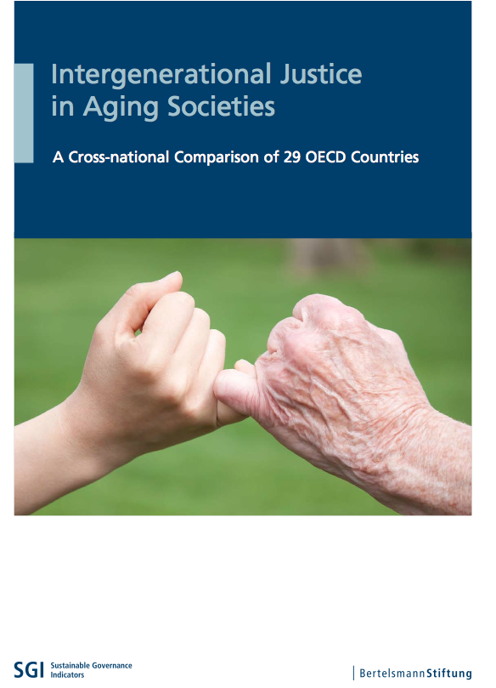
Thanks
Pieter Vanhuysse
Professor of Comparative Welfare State Research
University of Southern Denmark
vanhuysse@sam.sdu.dk
http://www.sam.sdu.dk/ansat/vanhuysse
Vanhuysse, P. (2013), Intergenerational Justice in Aging Societies: A Cross-national Comparison of 29 OECD Countries, Gütersloh: Bertelsmann Stiftung.
Oxford blog for demographers: http://www.openpop.org/?p=583
OECD Insights on the study: http://insightsblog.oecdcode.org/?p=6142

