Slide 1
Demographic Ageing, Europeanization and the Crisis in Croatia
Dr. Paul Stubbs
“Demographic Change in CEE”
Vienna, 24 March 2015

Slide 2
Contexts
Demographic ageing:declining population since 1991 (war, low birth rates, migration, ...)
Low and falling employment rates – high youth and long-term unemployment
In recession since 2009 (decline in real GDP of 12.5%)
EU Member State 1 July 2013 – Excessive Deficit Procedure since January 2014
EU-SILC 2013 AROPE
Overall: 29.9% - women 30.2%; men 29.6%
65+: 31.9% - women 35.3%; men 26.8%
75+: 36.5% - women 40.4%; men 29.4%
Pensions – high dependency ratios and low support ratios

Slide 3
Croatia 1st Pillar Pensions
Year (end of the period) | Contributors | Pensioners | Dependency ratio | Support ratio
1950 | 593,102 | 67,771 | 11,43% | 8.75
1960 | 912,290 | 176,978 | 19,40% | 5.15
1970 | 1,166,088 | 340,134 | 29.17% | 3.43
1980 | 1,518,049 | 438,133 | 28.86% | 3.46
1990 | 1,682,971 | 594,339 | 35.31% | 2.83
2000 | 1,380,510 | 1,018,504 | 73.78% | 1.36
2010 | 1,475,363 | 1,200,386 | 81.36% | 1.23
2011 | 1,468,133 | 1,213,121 | 82.63% | 1.21
2012 | 1,432,740 | 1,217,692 | 84.99% | 1.18
2013 | 1,400,631 | 1,190,815 | 85.02% | 1.18
2014 (Oct.) | 1,421,054 | 1,221,667 | 85.98% | 1.16
2014 (Dec.) | 1,397,400 | 1,223,738 | 87.76% | 1.14

Slide 4
Population projections
 | 2010 | 2035 | 2060
TOTAL m. | 4.425 | 4.206 | 3.862
0-19 | 0.933 (21.1%) | 0.801 (19.0%) | 0.701 (18.2%)
20-64 | 2.727 (61.6%) | 2.368 (56.3%) | 2.022 (52.4%)
65+ | 0.765 (17.3%) | 1.038 (24.7%) | 1.131 (29.3%)
75+ | 0.332 (7.5%) | 0.516 (12.3%) | 0.641 (16.6%)

Slide 5
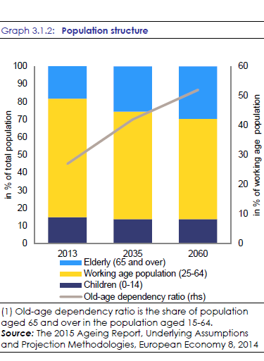
Demographic ageing

Slide 6
Croatian Social Policy
Hybrid/patchwork/mixed legacies (self-management and Bismarckism)
Captured and clientelistic (war veterans, ethnic Croats from BiH, pensioners...)
Late Europeanization and Variegated EU-ization (humanitarianism; Pre-accession JIM; EDP)
Welfare Parallelism (Local-National; State-NGO)
Embedded neo-liberalism and new conservatism?

Slide 7
Pension Reform 1995 - 2002
Crisis conditions (war, early retirement, Constitutional Court decision)
Preferred reform model (World Bank /Chilean model)
Technical fix (scenario modelling) in particular domestic and international political conditions
Absence of ANY EU position or ILO opposition
Implemented Argentinian model – mixed three pillar system (PAYG; mandatory savings; voluntary savings)
Considerable PR campaign

Slide 8
Sustainability
1st Pillar deficit 2014: 14 b. HRK (EURO 1.84 b)
14 ‘Privileged pension’ schemes – 15% of total, including 72,000 (6%) Veterans of the Homeland War (maximum pension set at double)
Equalised retirement age for men and women at 65 by 2030.
Between 2031 and 2038 retirement age for men and women gradually raised to 67.
Mixed messages on penalities for early retirement – lower in pre-election years – early retirement used to lower unemployment figures (rising early exits 2012-2014)
New in 2014: full pensions for anyone with 41 years’ contributions.
Projections 1st pillar pensions reduced from 10.9% of GDP in 2013 to 7.0% of GDP in 2060 (gap between payments and contributions reduced to 1.4% of GDP)

Slide 9
Adequacy
Extremely low aggregate replacement ratio (36% vs EU-28 56%) – fall from 47% in 2008
Extremely low and falling benefit ratio 31% - 27% (2030) – 22% (2060)
Theoretical replacement rates vary considerably but set to fall for all groups
First pillar pensions are progressively redistributive
30% of pensioners have less than 25 qualifying years (women 34% , men 26%)
Gender pension gap not as large as may be expected
Significant numbers of those retired receive no benefits
Average monthly pension 2014: 2,240 HRK (EURO 294) – War veterans: 5,134 HRK (EURO 675)

Slide 10
Impact of the Crisis
Incomes (though not material status) of older people more protected than working-age population
Limited and temporary cuts to some ‘privileged’ pensions (GDP growth and debt reduction ‘triggers’)
Indexation formula changes (2010/11 suspended; now favourable to pensioners)
Possibility of opting out from second pillar
Abandonment (postponement?) of JIM commitment to introduce ‘social pension’

Slide 11
Role of the European Union
Absent in first wave/radical pension reform
JIM – social pension and concern with minimum pension levels
European semester: concerns regarding both adequacy and sustainability
Concern regarding policy uncertainty and inefficiencies
Early retirement needs addressing
Gender harmonisation too slow
Lack of comprehesive active ageing strategy and enabling of longer working life

Slide 12
Conclusions
Complex mis-match between externally-driven reform agendas and internal political contingencies
No push to ‘renationalise’ second pillar
Little focus on linkage with long-term care needs
Gender dimension of pensioner poverty not addressed
Renewed discussion on guaranteed minimum income / social pensions

